Slide 1
Curriculum Learning for Sequential User Behavior
Modeling via Data Augmentation
CIKM 2021
2021.1.15 • ChongQing
Reported by Gu Tang

Slide 2
Introduction

Slide 3
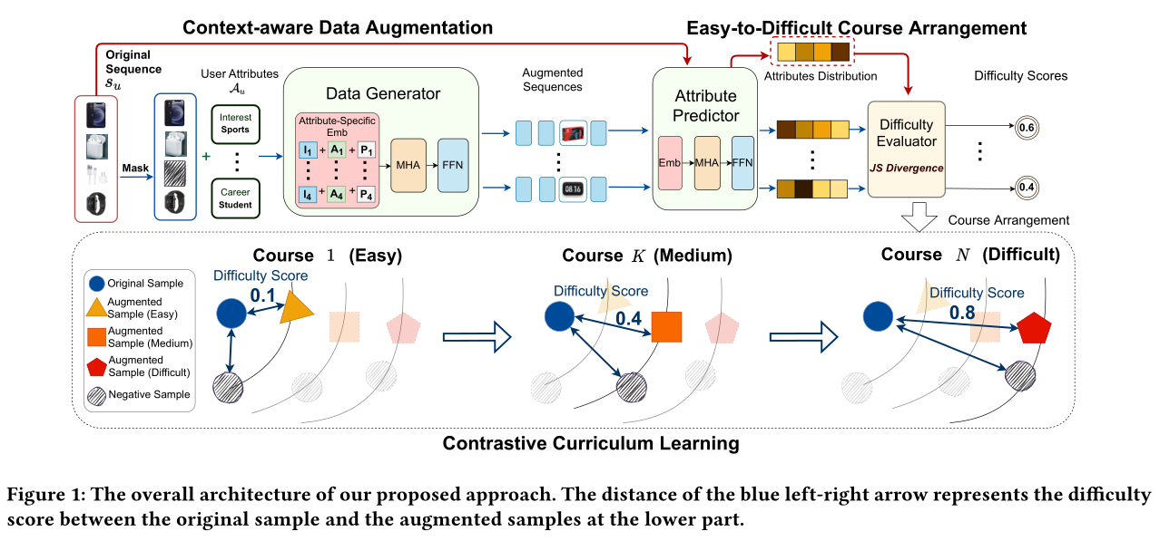
Method

Slide 4
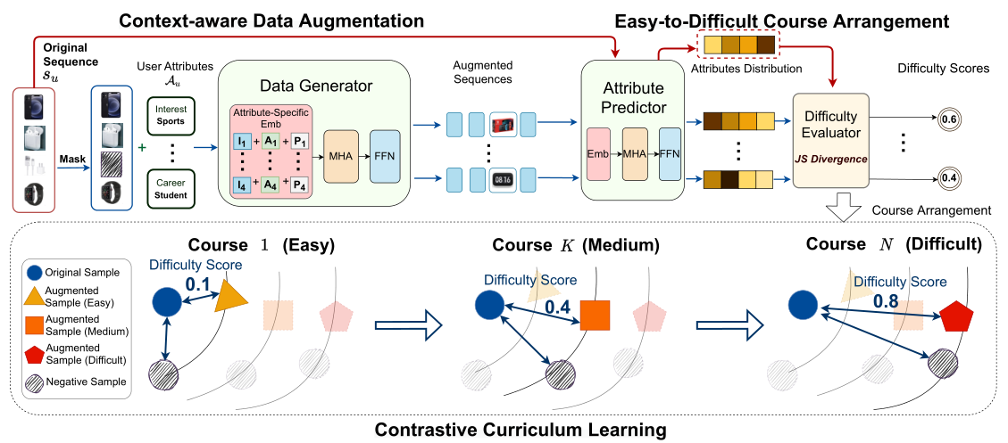
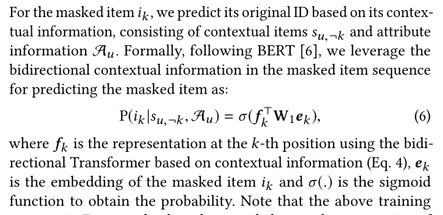
Method

Slide 5
Method

Slide 6
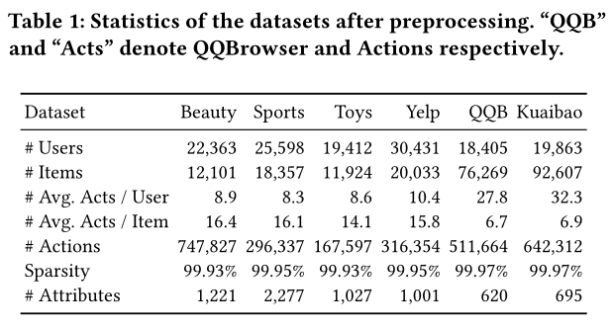
Experiment
Notes:
FD:有监督学习任务中项目塔上具有随机特征dropout的骨干模型。物品特征上的特征缺失可以看作是数据的增强。与我们的方法相比，FD没有额外的SSL规范化。
SO:主干模型以展布正则化对项目塔作为正则化。SO正规化与我们在SSL框架中共享类似的对比损失。然而，它是在原始例子上使用对比学习，没有任何数据扩充，因此与我们的方法不同。

Slide 7
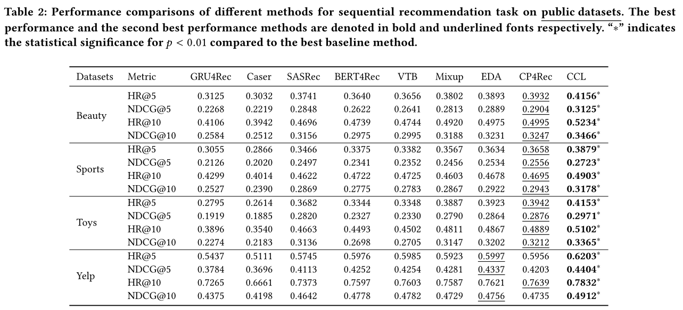
Experiments
Notes:
No_compl:没有mask互补特征。
No_dropout: Correlated Feature Masking with No Dropout
applied. In other words, only apply correlated masking as the
augmentation in the SSL task.
NoMasking: Correlated Feature Masking but skipping the mask-
ing phrase in augmentation. In other words, we only apply
dropout to features as the augmentation.

Slide 8
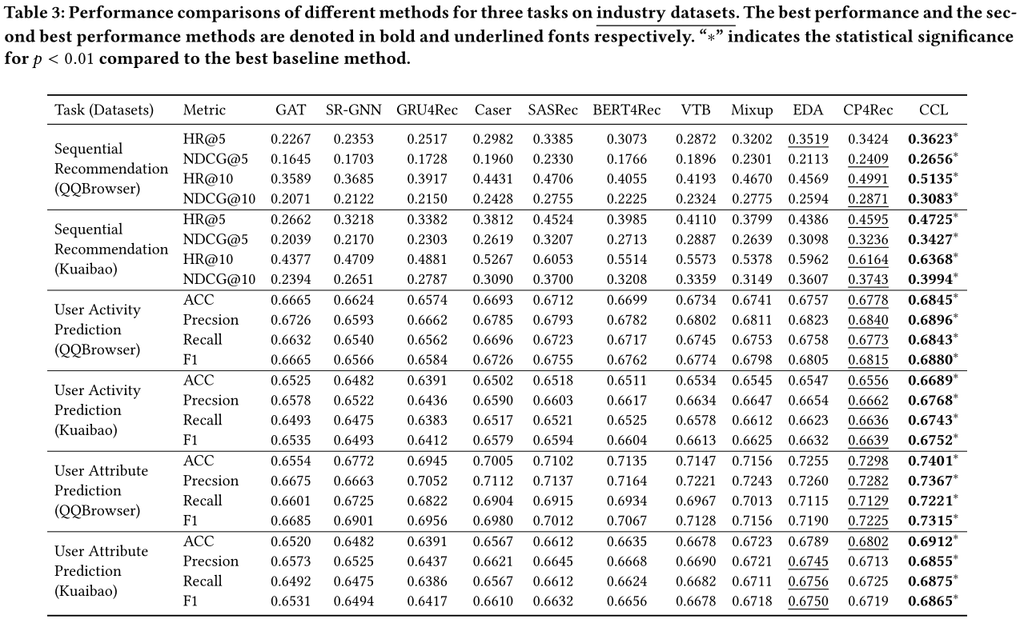
Experiments

Slide 9
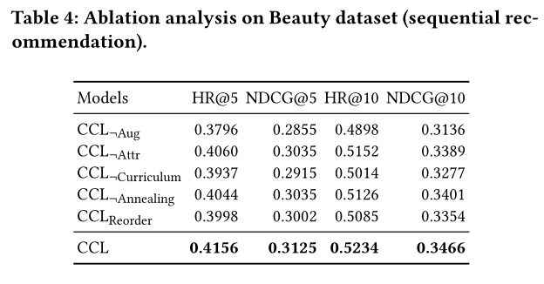
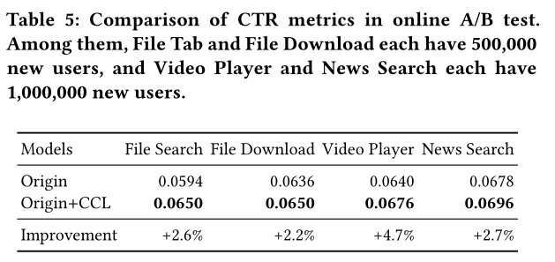
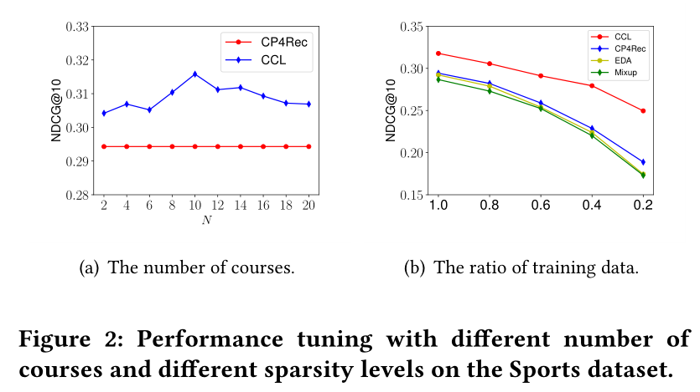
Experiments

Slide 10
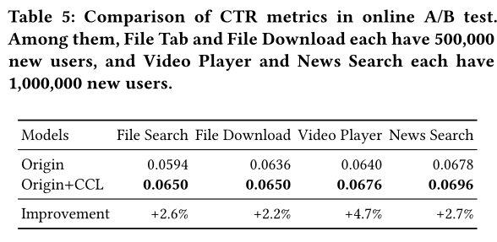
Experiments

Slide 11
Thanks

